Slide 1
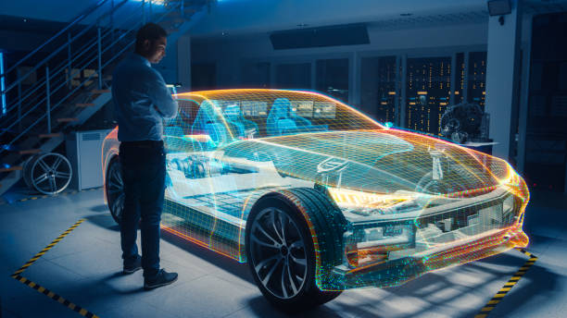
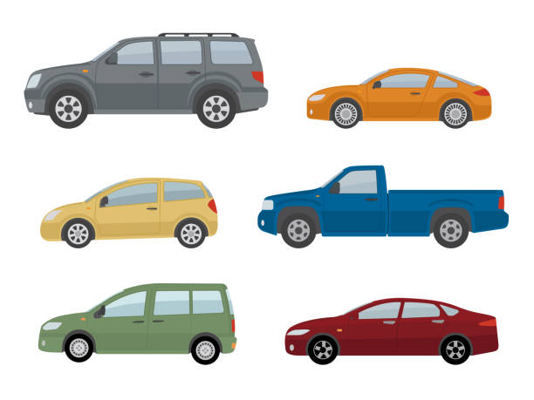
Alec Henderson, Andrew Paton, Vilma Diaz, Celena Blackwood, Dan Tinarwo
Notes:
Note: this Project has been Evaluated in 34 different brands Between Pickup, Sedans, Suv.

Slide 2
https://www.kaggle.com/cisautomotiveapi/large-car-dataset
Sedans, Pickups, SUV
Data set Clean has been conducted by
Andrew Appaton, Alec Henderson and Dan Tinarwo
Visualization has been conducted by
Alec Henderson, Dan Tinarwo, Vilma Diaz, Celena Blackwood
Precentation PowerPoint
Vilma Diaz + Team.
Signature: Team-Project# 4

Slide 3
Problem Solving Hypothesis
01
Presentation
Agenda
02
Sedan Supply and Demand Analysis
03
Pickup Regression Analysis
04
SUV-Data analyzes
Questions
05
Notes:
Steps: Explanations

Slide 4
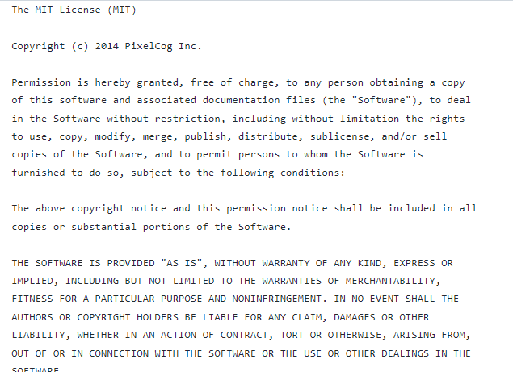
License = parallax.js-1.3.1
Notes:
Note: License and Parameters.

Slide 5
Executive Summary
01
02
Cleaning Data
03
Data Source
Data Analysis
Our data source features more than 5.7 million records of car sales in Illinois over the time period of 2018-2020
We cleaned the data by splitting it into two groups (Sedans, Pickup Trucks). From there we removed all outliers for both price and mileage. Further reduction to the data set was made by dropping columns that had less than 95% missing records.
We preformed both a volume to price analysis and mileage to price regression analysis.
Project-4 Team:
Excuse any typos
Notes:
Note: Analysis has been made on Pickups, SUV, Sedans

Slide 6
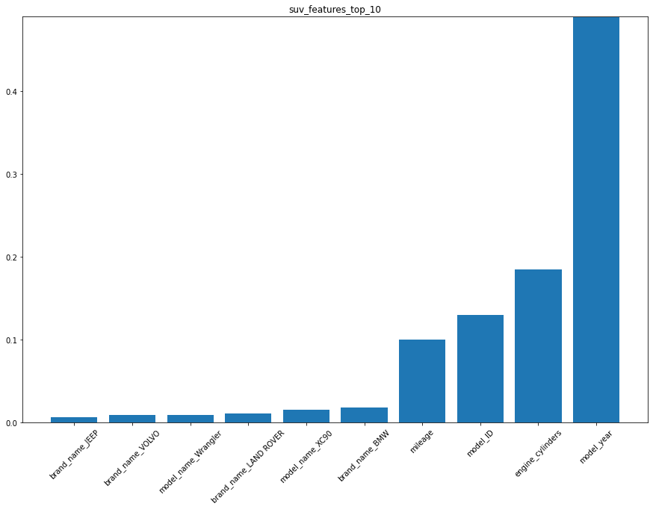
Model & Results-top-10
Models-Results by Brands:
Brands Names = JEEP
Brands Names = VOLVO
Brands Names = WRANGLER
Brands Names = LAND-ROVER
Brands Names = XC90
Brands Names = BMW
The Fundamentals That Affect Price
Signature: Eric Team # 4

Slide 7
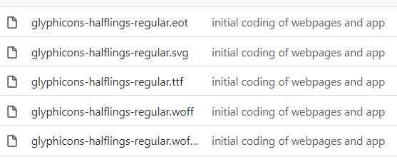
Brand popularity
PICKUP,SEDANS,SUV
Bootstrap v3.3.6 (http://getbootstrap.com)
Source Mapping.URL=bootstrap min css map
Categorical listing of different brands
Key take-away
The higher the supply the lower the price demanded for the car.
Signature: Celena Team # 4
Notes:
Static Fonts:

Slide 8
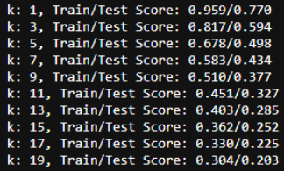
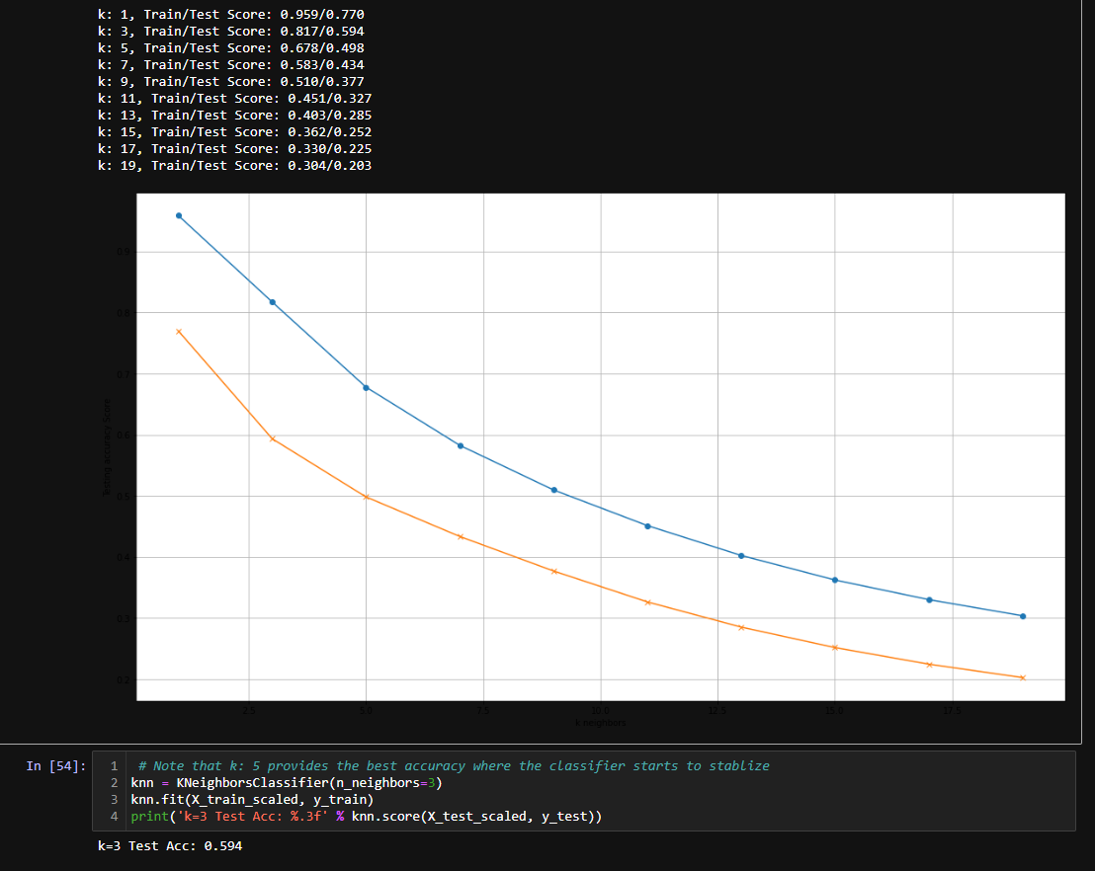
mileage on Sedans
Findings
SKNN Analysis Train/Test Score
Signature: Eric Team # 4

Slide 9
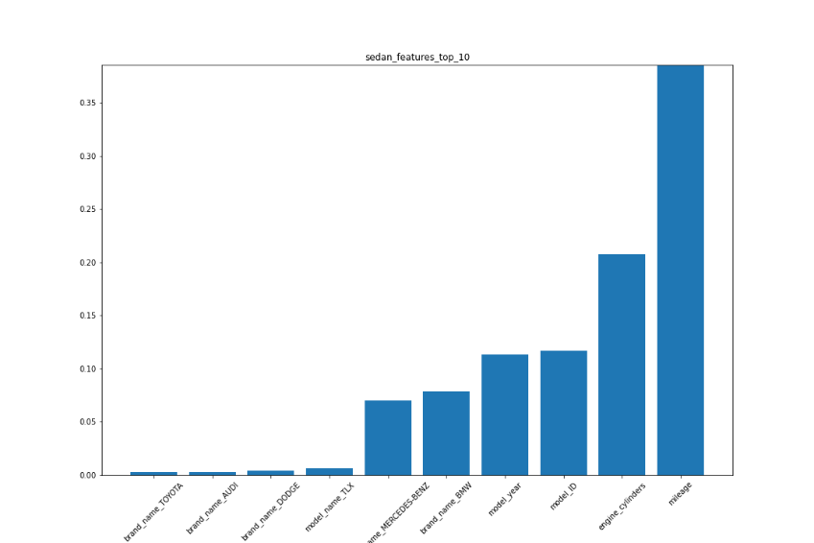
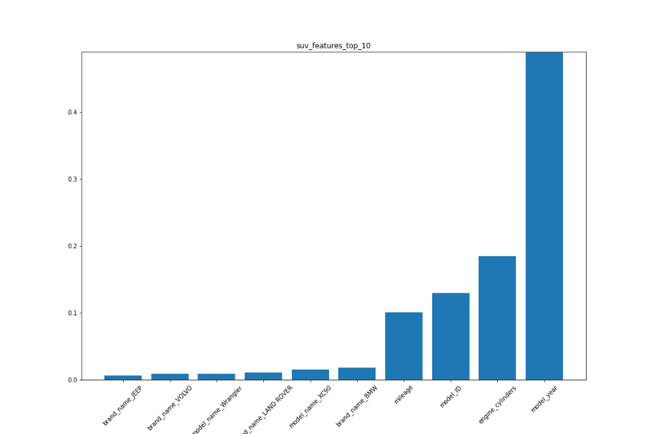
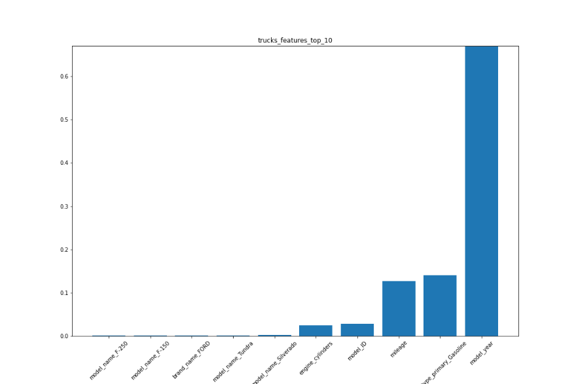
Visualizations/Top Features.
Sedans_features_top_10
Toyota
Audi
Dodge
TLX
Mercedes-Benzes
BMW
Cylinders
ID
Mileages
Gasoline
Year
Suv_features_top_10
JEAP
VOLVO
Wrangler
Land Rover
XC90
BMW
Cylinders
ID
Mileages
Gasoline
Year
Pickup_features_top_10
F-150
FORD
Tundra
Silverado
Cylinders
ID
Mileages
Gasoline
Year
Signature: Eric Team # 4
Notes:
Visualization for all 3 Types

Slide 10
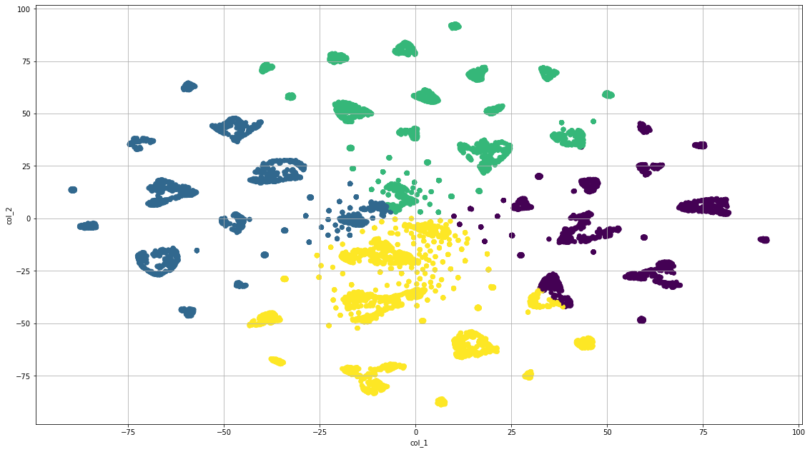
k_means_perplexity_50_sample10k
Signature: Eric Team # 4
Notes:
Git status!

Slide 11

Challenges
more Categories
Missing data in records
We suggest that more categories be used in regression models to separate the highly expensive trim cars from the budget trim cars. Mixing these results gave us a high variability in starting price.
Of the 156 columns less than 1/8 had 95% complete data. This left us with a high amount of records with few identifiers.
Nationwide
incorrect records
Use a web scraping program to pull current data from across the untied states. This will both lessen the regional impact as well as provide complete data.
Within the identify columns, we had mislabeled or record entries that were of no use to the study.
Model year
Initial data size
Only compare the same model and model year in the regression model to eliminate design updates.
The data was originally stored in a 5.7GB .CSV file. This was too large to handle by laptop. Therefore we needed to chunk this into several smaller files. Should a web scrapping program be used or an API, it would be more manageable.
Notes:
Team: Project #4

Slide 12
Questions!
Notes:
Thank you!!!!!!

